Slide 1
jQuery and AJAX
Week 14

Slide 2
What is AJAX?
AJAX enables seamless communication with a server to retrieve or send data, allowing specific sections of a web page to update dynamically without requiring a full page reload.
AJAX stands for Asynchronous JavaScript and XML.

Slide 3
jQuery and AJAX
jQuery offers a variety of tools to implement AJAX features. These methods allow you to retrieve text, HTML, XML, or JSON data from a remote server using either HTTP GET or POST requests, and then seamlessly insert that data into specific elements on your web page.

Slide 4
jQuery load() Method
jQuery offers a variety of tools to implement AJAX features. These methods allow you to retrieve text, HTML, XML, or JSON data from a remote server using either HTTP GET or POST requests, and then seamlessly insert that data into specific elements on your web page.

Slide 5
jQuery load() Method
The jQuery load() method is a straightforward yet highly effective AJAX tool. It retrieves data from a server and inserts the response directly into the chosen HTML element.
Syntax:
  $(selector).load(URL, data, callback);
  The load() method lets you fetch data from a server and insert it directly into a chosen HTML element — all without refreshing the page.
selector → The element where the content will be placed
URL → The server file or resource you’re loading
data (optional) → Key-value pairs sent to the server
- callback (optional) → A function that runs after the content is loaded

Slide 6
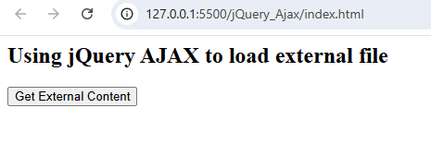
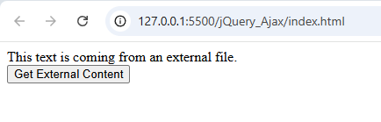
Loading a text file
<html>
<head>
<script src="https://ajax.googleapis.com/ajax/libs/jquery/3.7.1/jquery.min.js"></script>
<script>
$(document).ready(function(){
$("button").click(function(){
$("#container").load("content.txt");});});</script></head>
<body>
<div id="container"><h2>Using jQuery AJAX to load external file</h2></div>
<button>Get External Content</button>
</body>
</html>

Slide 7
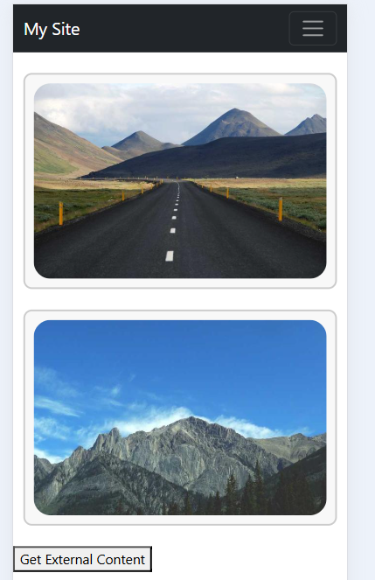
Loading an HTML page
<html>
<head>
<script src="https://ajax.googleapis.com/ajax/libs/jquery/3.7.1/jquery.min.js"></script>
<script>
$(document).ready(function(){
$("button").click(function(){
$("#container").load("test.html");});});</script></head>
<body>
<div id="container"><h2>Using jQuery AJAX to load external file</h2></div>
<button>Get External Content</button>
</body>
</html>

Slide 8
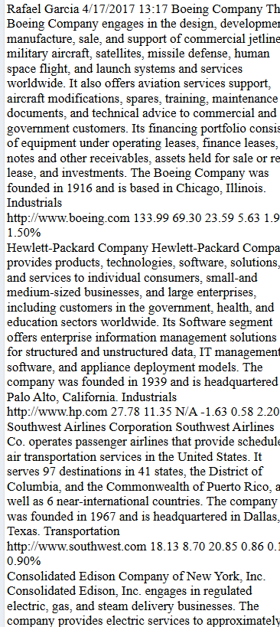
Loading an XML page
<html>
<head>
<script src="https://ajax.googleapis.com/ajax/libs/jquery/3.7.1/jquery.min.js"></script>
<script>
$(document).ready(function(){
$("button").click(function(){
$("#container").load("portfolio.xml");});});</script></head>
<body>
<div id="container"><h2>Using jQuery AJAX to load external file</h2></div>
<button>Get External Content</button>
</body>
</html>

Slide 9
Reference
https://www.w3schools.com/jquery/jquery_ajax_intro.asp

